Slide 1

Into the chaos
Introduction to The chaos engineering

Slide 2

About me
Software developer @ Demant Technology Centre
Consultant, trainer, architect
Book author
French bulldog owner
Microsoft Azure MVP
@Kamil_Mrzyglod
http://blog.codenova.pl

Slide 3
Agenda
Concept
History
Different models
Development
Testing
DevOps

Slide 4
Concept of Chaos
...and all shall be chaotic!

Slide 5

A typical day in a company…

Slide 6
Suddenly…

Slide 7
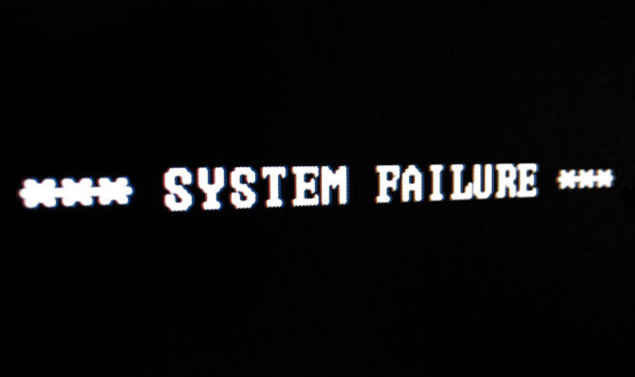

Slide 8
What leads to…

Slide 9


Slide 10
What can go wrong?
Infrastructure failure
Network failure
Application failure
Human error

Slide 11
How one can be secured against a random error?

Slide 12
History Of Chaos
…and only chaos shall remain!

Slide 13
Let’s go back in time
It’s 2011, Greg Orzell(systems and cloud architect @ Netflix), was supporting the migration of the company’s systems to the cloud
He tried to address the lack of the proper resiliency testing
He proposed a tool, which will create breakdowns in the production environment

Slide 14


Slide 15


Slide 16
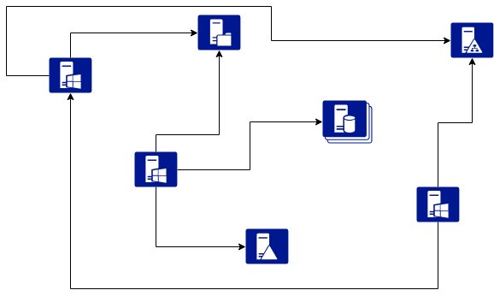
Typical architecture

Slide 17
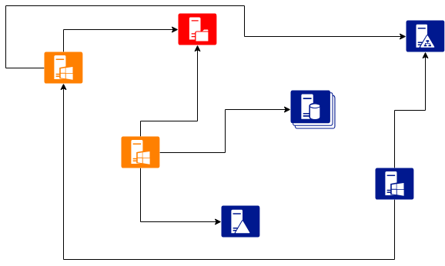
File server goes down…

Slide 18
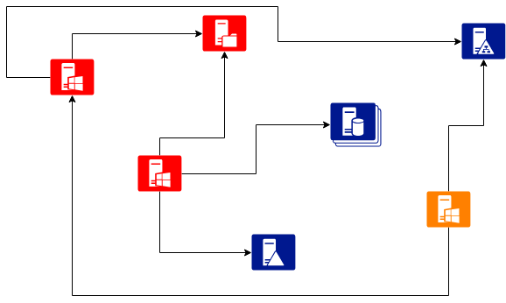
System starts to collapse…

Slide 19
Models Of chaos
…Thy art is chaos!

Slide 20
Instance- Intentionally disables computers in the production network
Data centre – Drops an entire Availibility Zone
Latency – simulates communication delays
Janitor – identifies and disposed unused resources
Conformity – tests an instance against a set of rules
Security – searches and disables instances with vulnerabilities
Internationalization – detects probles with localization and internationalization
Byte – instrument application code on the fly to introduce faults

Slide 21
Development of chaos
…in chaos we trust!

Slide 22
The first rule…
Push yourself to the extreme.

Slide 23
The Second rule…
Build redundancy and process automation.

Slide 24
The third rule…
NEVER Be surprised.

Slide 25
Testing of chaos
…thou shall embrace chaos!

Slide 26
Toolkit of a tester
Chaos Toolkit – an open-source tool allowing you to experiment on different levels: infrastructure, platform and application.
Co-operation – you have to understand both the behaviour of an application and release pipelines so work closely with devs
Courage – do not be afraid of breaking the production environment!

Slide 27

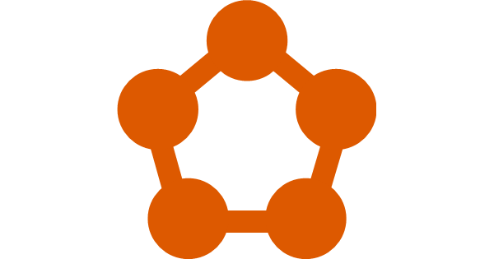

Toolset

Slide 28
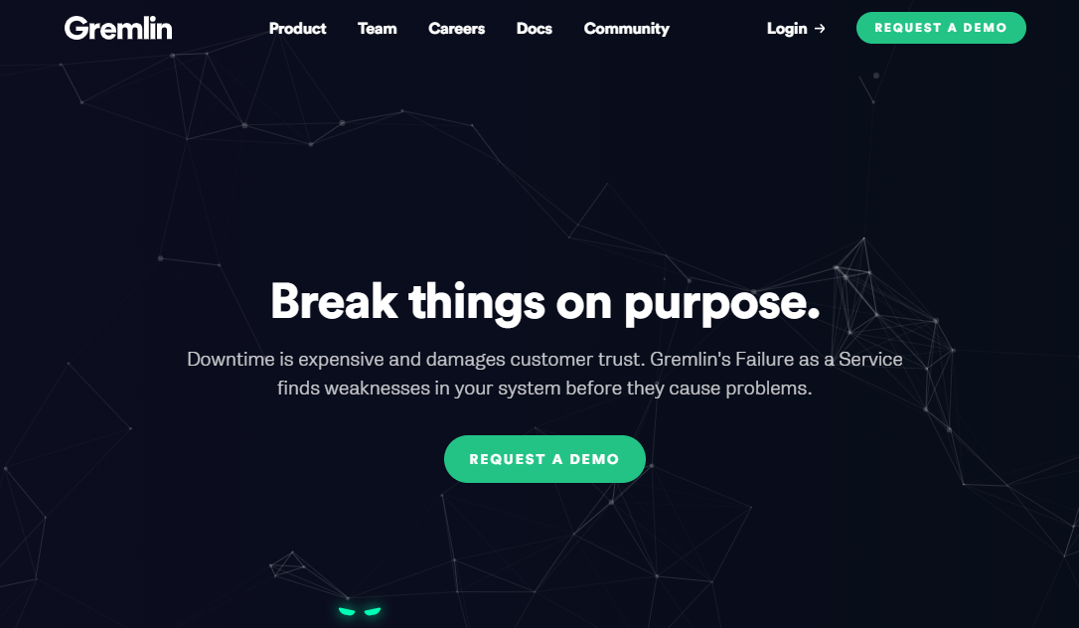

Slide 29

Azure Service fabric scenarios
Restart a node to simulate any number of situations where a machine or VM is rebooted.
Move a replica of your stateful service to simulate load balancing, failover, or application upgrade.
Invoke quorum loss on a stateful service to create a situation where write operations can't proceed because there aren't enough "back-up" or "secondary" replicas to accept new data.
Invoke data loss on a stateful service to create a situation where all in-memory state is completely wiped out.

Slide 30

Currently retired
Still available on GitHub
Some functionalities moved to other projects

Slide 31
Devops of chaos
…bring order into chaos!

Slide 32
Failure is common
Logic is rare

Slide 33
Vectors of failure
Software issues(bugs, exceptions, attacks)
Infrastructure outages(network partitioning, VMs updates, packet loss/delay)
Hardware breakdowns(disk failures)
CPU/RAM limits

Slide 34
Variety of tools
Pod-reaper – for killing containers(chaos in Kubernetes)
Toxiproxy – TCP proxy for simulating network issues
Pumba – chaos testing for Docker
Namazu(Earthquake) – a scheduler for scheduling a catastrophe(non-deterministic)
And many more…

Slide 35
Links
https://principlesofchaos.org/
https://github.com/dastergon/awesome-chaos-engineering

Slide 36
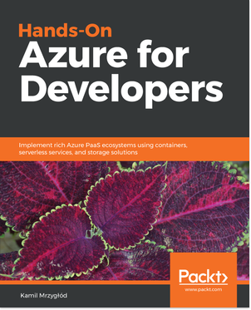
eBook: JHOAD50
Book: JHOAD15

Slide 37

Thank you

